Slide 1
AWS Route 53 (DNS)
Enhancing Domain Management and Global Traffic Optimization

Slide 2
Agenda
Introduction to Route 53
Key Features and Benefits
Routing Policies
Hosted Zones and Record Types
Integration with AWS Services
Use Cases
Real-World Examples
Demo (Optional)
Summary

Slide 3

Amazon Route 53
A highly available and scalable Domain Name System (DNS) web service from AWS.
Primary Functions:
Domain registration.
DNS routing.
Health checks and traffic management.
Why Route 53?
Global availability.
Seamless integration with AWS services.
Highly reliable and secure.

Slide 4
Key Features and Benefits
Features:
Domain Registration: Register and manage domain names directly from AWS.
DNS Management: Create and manage DNS records for domains.
Health Checks: Monitor the health of resources and reroute traffic if needed.
Traffic Flow: Optimize traffic globally with routing policies.
Integration: Works seamlessly with other AWS services.
Benefits:
High Availability: Built-in redundancy for reliable DNS service.
Scalability: Supports traffic for large-scale applications.
Security: DNSSEC support for secure DNS management.

Slide 5
Routing Policies
Simple Routing: Basic DNS resolution for a single resource.
Weighted Routing: Distribute traffic based on assigned weights.
Latency Routing: Directs traffic to the region with the lowest latency.
Geolocation Routing: Routes traffic based on user location.
Failover Routing: Ensures high availability by redirecting traffic to a backup resource.
Multi-Value Answer: Returns multiple IP addresses for redundancy.

Slide 6
Hosted Zones and Record Types
Hosted Zones:
Public Hosted Zone: Manages DNS records for domains accessible on the internet.
Private Hosted Zone: Manages DNS records for internal AWS resources.
Record Types:
A (Address Record): Maps domain to an IPv4 address.
AAAA: Maps domain to an IPv6 address.
CNAME: Alias for another domain name.
MX: Mail exchange server.
TXT: Holds text information for verification or other purposes.

Slide 7
Integration with AWS Services
Works seamlessly with services like:
Elastic Load Balancer (ELB) for distributing traffic.
CloudFront for content delivery.
S3 for static website hosting.
Enables advanced configurations:
Automatically updates DNS records for Auto Scaling groups.
Secure domain connections with ACM (provides SSL).

Slide 8
Use Cases
E-commerce Platforms:
Efficiently handle global traffic with geolocation routing.
Global Applications:
Ensure low-latency access using latency-based routing.
Disaster Recovery:
Maintain availability using failover routing.

Slide 9
Real-World Example
A global SaaS provider uses Route 53 for:
Managing domains across regions.
Ensuring high availability with failover routing.
Optimizing user experience with latency-based routing.
Metrics:
Improved global accessibility.
99.99% uptime for critical applications.

Slide 10
Demo
Step 1: Create a hosted zone in the AWS Management Console.
Step 2: Add DNS records (A, CNAME, etc.).
Step 3: Configure routing policies.
Step 4: Test DNS resolution using tools like nslookup.

Slide 11
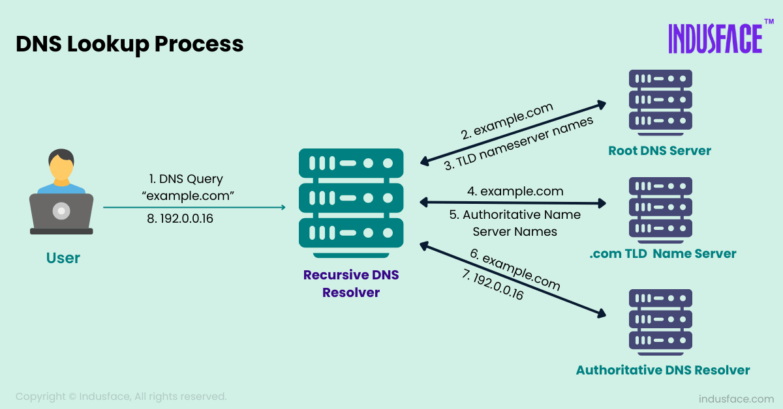

Slide 12
Summary
Route 53 offers a scalable and reliable DNS service.
Supports advanced traffic management with various routing policies.
Seamless integration with AWS services ensures global optimization.

